Slide 1

INDIAN CRIME ANALYSIS DASHBOARD – 2020-2024

Slide 2
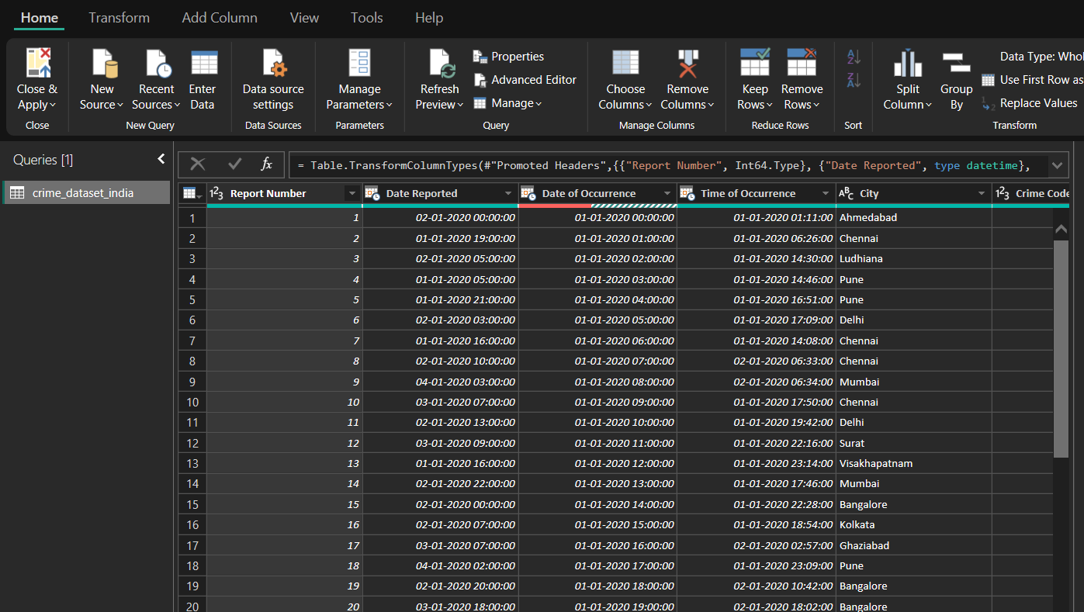
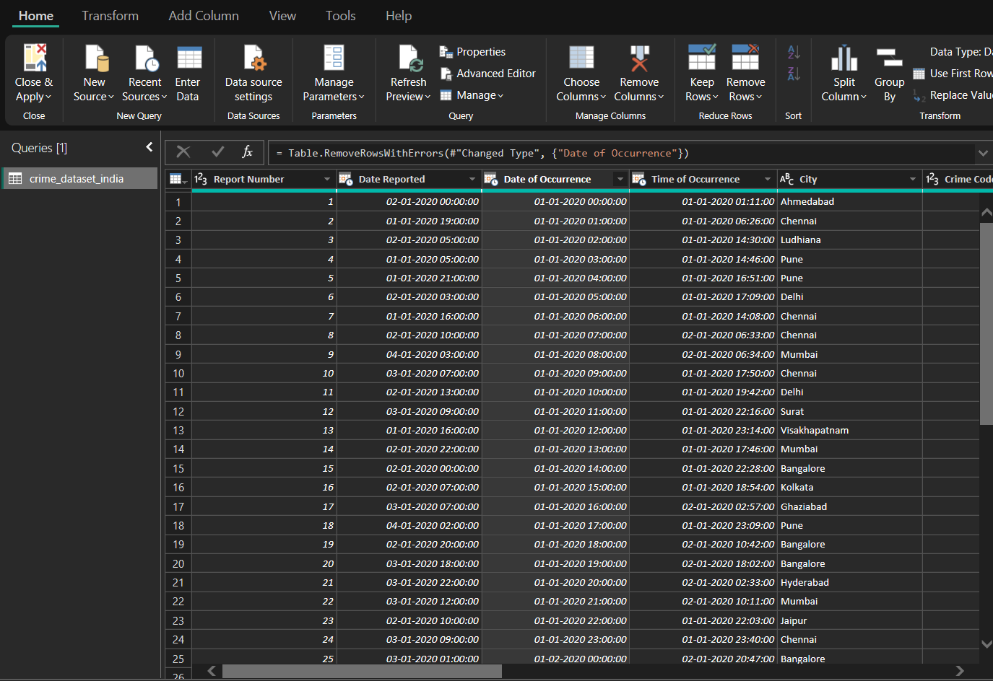
TRANSFORMATION & CLEANING

Slide 3
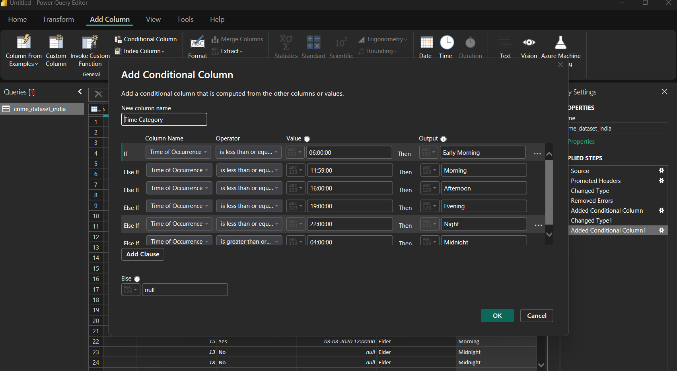
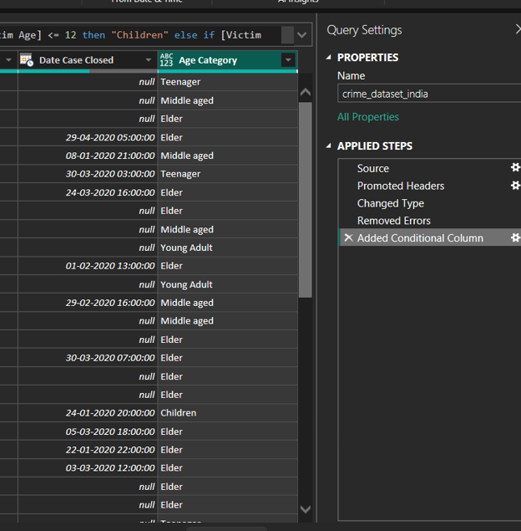
DAX & CONDITIONAL COLUMNS

Slide 4
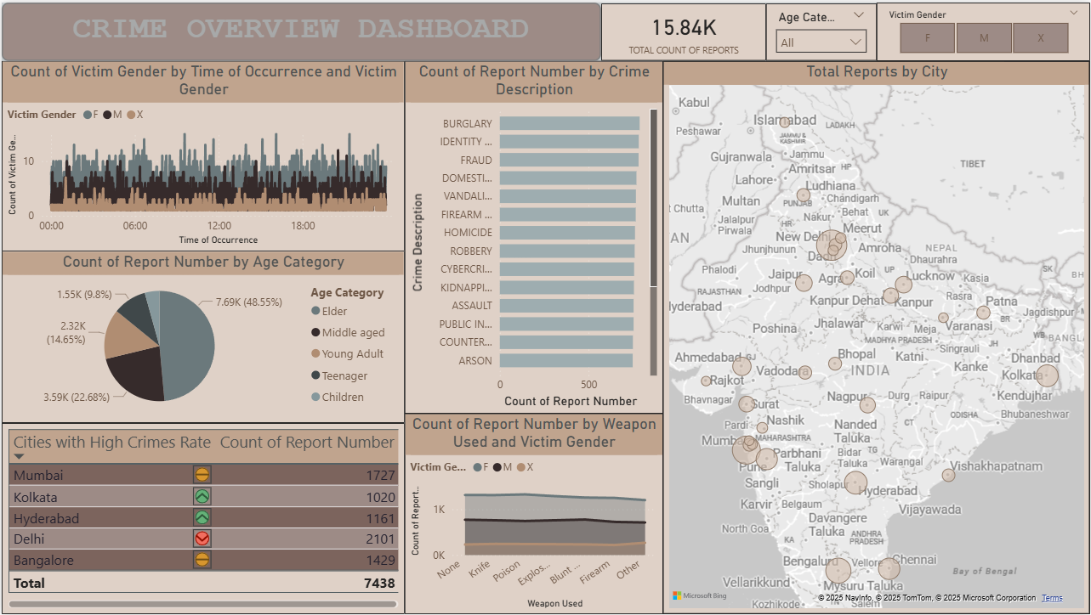

Slide 5
